Slide 1
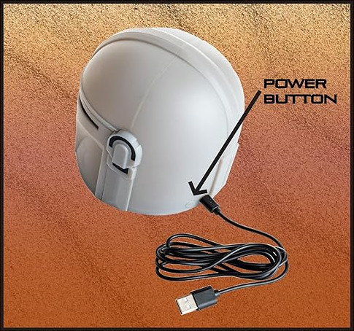
Micro USB port
5V DC 500mA

Slide 2
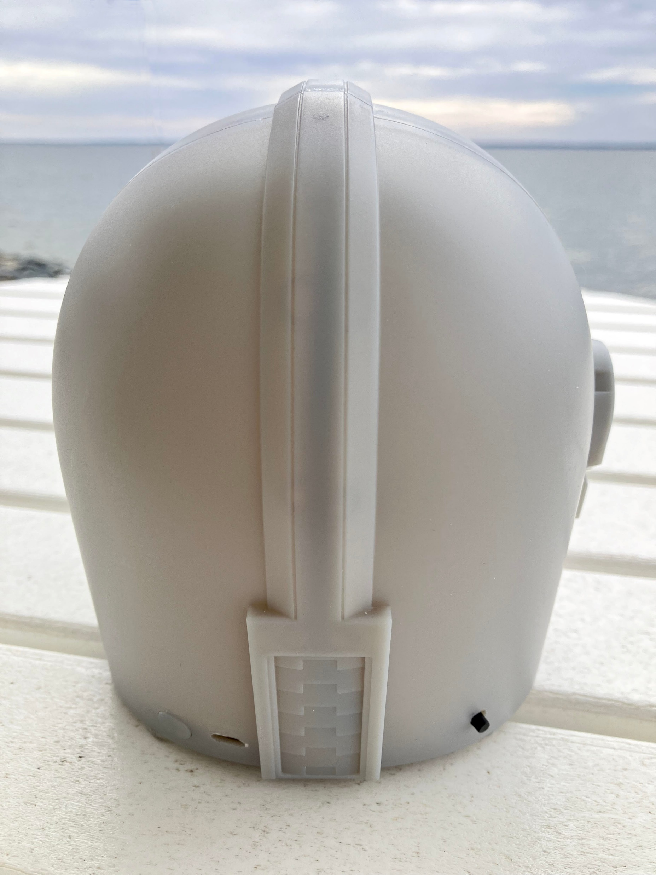



Touch sensor
Sound button
Power button
Micro USB port

Slide 3
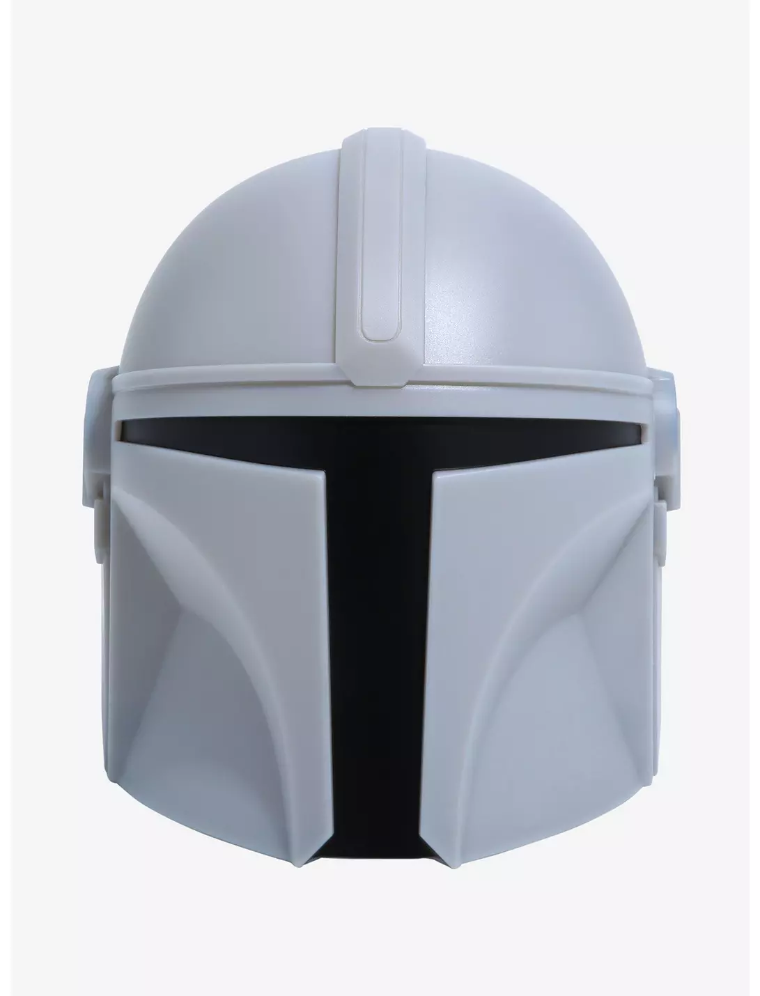
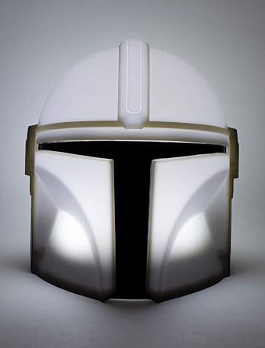
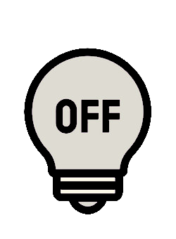

Power button

Slide 4

Tap
Soundbite
Hold
Touch sensor
Glowing lamp

Slide 5

1 X
Soundbite
2 X
Sound button
Music

